Slide 1
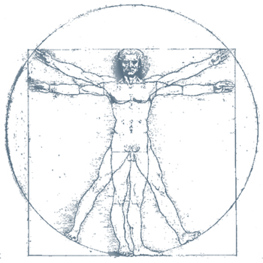
Character Name
Project Name

Slide 2
TABLE OF CONTENTS
✤ Narrative
☙ Character Name
☙ Narrative Overview
⚊ Narrative Notes
☙ Plot Outline
✤ Physical Information
☙ Physical Description
✤ Personality & Preferences
☙ Personality
⚊ Personality Spectrum
☙ Preferences
⚊ Favorites
✤ Relationships
☙ Family
☙ Love Interest(s)
☙ Friends/Sidekicks
☙ Enemies
☙ Mentors
☙ Other Connections
✤ Background
☙ Circumstances of Birth
☙ Childhood
☙ Adolescence
☙ Young Adulthood
☙ Adulthood
✤ Abilities
✤ Economic Information
✤ Belongings
☙ Clothing
☙ Other Belongings
1
1
1
1
2
3
3
4
4
5
6
6
7
7
7
7
8
8
8
9
9
9
9
10
10
11
11
12
12
13
Character Outline v1.0 by apheline, 2018

Slide 3
NAME
Role/Title
Other Names:
Nicknames, handles, past names, etc.
NARRATIVE OVERVIEW
One Sentence Summary:
A one-sentence summary of the character’s storyline
Summary:
A one-paragraph summary of the character's storyline, motivation and description
Motivation(s):
What do they want abstractly?
Goal(s):
What do they want concretely?
Conflict(s):
What prevents them from reaching their goal(s)?
Epiphany:
What will they learn? How will they change?
Archetype:
Hero, mentor, ally, herald, trickster, guardian, shadow, shapeshifter, etc.
NOTES
Describe how this character changes over the course of the story
Provide any notes about this character’s journey throughout the story
Character Outline v1.0 by apheline, 2018
1

Slide 4
PLOT OUTLINE
List plot points that this character will explore throughout the story
Character Outline v1.0 by apheline, 2018
2

Slide 5

PHYSICAL INFORMATION
Gender:
Height:
Place Picture Here
Frame Build:
Brawny, thin, etc.
Weight:
Species:
Blood Type:
Ethnicity:
Age:
Nationality:
Ancestry:
Complexion:
Dark, light, tan, pale, etc.
Vocal Range/Style:
Shriek, articulate, high-pitched, rumbling, etc.
Hair:
Color
Length
Style
Facial Hair:
Color
Style
Eyes:
Color
Style
Face Size:
Broad/narrow/etc.
Foot Size:
Handedness:
Right/Left/Ambidextrous
Tattoos:
Number, placement, type, etc.
Scars:
Placement, size, etc.
Identifying Marks:
Moles, birthmarks, freckles, piercings, large or small body parts, etc.
Clothing:
Style, type, manner of dress, jewelry, makeup, etc.
Poise:
How does this character hold themself?
Notes:
What is this character's best physical trait? Their worst?
What element of their appearance is this character the most insecure about?
Why do they enjoy wearing specific clothes/colors/etc.?
What does this character's smile look like?
PHYSICAL DESCRIPTION
A paragraph or two on the physical description of the character
Character Outline v1.0 by apheline, 2018
3

Slide 6
PERSONALITY
Personality Type:
Meyer’s Briggs, Type A/B, etc.
General Attitude:
What is this character’s standard emotional state? Happy, outgoing, depressed, etc.
Role Model(s):
Who does this character look up to? Historical figures, friends, mentors, etc.
Best Qualities:
Loyalty, honesty, kindness, responsibility, intelligence, etc.
Vices:
Rashness, cowardice, vulgarity, pettiness, short tempered, etc.
Habits:
Smokes, sleeps in late, emotional shopper, etc.
Quirks:
Callous, snobbish, addictive personality, overly bold, talks too loud, etc.
Mannerisms:
Bites nails, rubs chin, bites lip, etc.
Fears:
Spiders, the dark, water, etc.
Speaking Style:
Articulate, incoherent, eloquent, fast-talking, conversation dominator, always gets the last word, speaks loudly, etc.
Communication Style:
Verbal, sign language user, uses written word, etc.
Type of Laugh:
Snorts, guffaws, snickers, cackles, giggles, mirthless laugher, rarely laughs, etc.
Presence:
Looming, clumsy, commanding, elegant, slow, methodical, fidgety, etc.
Beliefs:
Religious, educational, etc.
PERSONALITY DESCRIPTION
A paragraph or two about the character’s personality.
How does this character express emotion?
What sorts of things make them cry? Laugh? Angry?
How easy/hard is it for others to read their emotions?
What are the core values of this character? How are they willing to fight for those values?
Character Outline v1.0 by apheline, 2018
4

Slide 7
PERSONALITY SPECTRUM
Where does the character fall on these scales at different times during the story? Use the numbers below or create your own to mark the lines. Delete this text and unused place markers before printing.
Irresolute
1
2
3
Tenacious
Rebellious
Obedient
Imaginative
Realistic
Pessimistic
Optimistic
Gullible
Skeptical
Introverted
Extroverted
Unwilling
Agreeable
Idle
Productive
Hurried
Meticulous
Conservative
Liberal
Subjective
Objective
Excitable
Calm
Hesitant
Confident
Selfish
Benevolent
Aloof
Affectionate
Character Outline v1.0 by apheline, 2018
5

Slide 8
PREFERENCES
Likes:
Jump rope, eggplant, etc.
Loves:
Food, music, sunsets, etc.
Dislikes:
Loud noises, spinach, waking up early, etc.
Hates:
Thunderstorms, zealots, war, etc.
Sexual Preferences:
Bisexual, homosexual, heterosexual, asexual, monogamous, polyamorous, etc.
Learning Preferences:
Verbal, written, auditory, visual, kinesthetic, tactile, active, reflective, etc.
Sleeping Preferences:
Early bird, night owl, etc.
Philosophical Leanings:
Nihilistic, logical, Darwinist, absurdist, intellectual, etc.
Political Sentiments:
Conservative, liberal, anarchist, communist, etc.
Coping Strategies:
How does this character cope with stressful or painful situations? Do they have any defense mechanisms?
FAVORITES
Food
Drink
Color
Book
Game
Music
Possession
Animal
Place
Weather
Person
Hobby
Clothing
Store
Exercise
Flower
Character Outline v1.0 by apheline, 2018
6

Slide 9
RELATIONSHIPS
FAMILY
Type of Relation
Status
Relation’s Name
How are things between the character and this relation?
Type of Relation
Status
Relation’s Name
How are things between the character and this relation?
Type of Relation
Status
Relation’s Name
How are things between the character and this relation?
Type of Relation
Status
Relation’s Name
How are things between the character and this relation?
Type of Relation
Status
Relation’s Name
How are things between the character and this relation?
LOVE INTEREST(S)
Name of Love Interest 1
Summary of who they are and how they are important to this character
Name of Love Interest 2
Summary of who they are and how they are important to this character
Name of Love Interest 3
Summary of who they are and how they are important to this character
FRIENDS/SIDEKICKS
Name of Friend 1
Summary of who they are and how they are important to this character
Name of Friend 2
Summary of who they are and how they are important to this character
Name of Friend 3
Summary of who they are and how they are important to this character
Character Outline v1.0 by apheline, 2018
7

Slide 10
ENEMIES
Name of Enemy 1
Summary of who they are and how they are important to this character
Type of Relation
Name of Enemy 2
Summary of who they are and how they are important to this character
Type of Relation
Status
MENTORS
Name of Mentor 1
Summary of who they are and how they are important to this character
Name of Mentor 2
Summary of who they are and how they are important to this character
OTHER CONNECTIONS
Type of Relation
Status
Relation’s Name
How are things between the character and this relation?
Type of Relation
Status
Relation’s Name
How are things between the character and this relation?
Type of Relation
Status
Relation’s Name
How are things between the character and this relation?
Type of Relation
Status
Relation’s Name
How are things between the character and this relation?
Type of Relation
Status
Relation’s Name
How are things between the character and this relation?
Type of Relation
Status
Relation’s Name
How are things between the character and this relation?
Type of Relation
Status
Relation’s Name
How are things between the character and this relation?
Type of Relation
Status
Relation’s Name
How are things between the character and this relation?
Type of Relation
Status
Relation’s Name
How are things between the character and this relation?
Character Outline v1.0 by apheline, 2018
8

Slide 11
BACKGROUND
CIRCUMSTANCES OF BIRTH
Birthdate:
Birth Time:
Birth Place:
Astrological Information:
Was this character born under a certain sign?
CHILDHOOD
Where was your character born?
How did their earliest years shape who they became?
Describe your character’s family, childhood and circumstances. What structure did the family provide or not provide?
What major childhood influences, traumas, events, and emotional wounds have shaped your character?
Who was the most significant person in his/her childhood?
What was the best part of this character's childhood? The worst?
ADOLESCENCE
Families (or lack thereof) define us and shape who we are.
What experiences shaped this character at a young age?
What was this character's education like? Were they raised on the street? Were they taught by a private tutor? Did they attend a school?
What friends did your character have?
Did your character stay in one place or move around?
What was the best part of this character's adolescence? The worst?
Character Outline v1.0 by apheline, 2018
9

Slide 12
BACKGROUND
YOUNG ADULTHOOD
What events from young adulthood still influence this character today?
Did your character have any relationships?
Did this character have trouble transitioning into adulthood or did they excel at it?
What challenges did this character face?
What social groups was this character drawn to? Which groups did they grow to dislike?
What skills did this character develop as they grew?
What was the best part of this character's young adulthood? The worst?
ADULTHOOD
What place has this character found in the world?
Have they adapted to adulthood well or do they long for the simplicity of youth?
What regrets does this character have?
What have they achieved? What goals still remain for them?
How have this character's relationships changed as they reached adulthood?
What experiences does your character feel good or bad about?
What is the most embarrassing thing that has happened to this character?
Character Outline v1.0 by apheline, 2018
10

Slide 13
ABILITES
Skills:
What have they trained to do?
Talents:
What do they just have a knack for?
Hobbies:
What do they enjoy doing?
Languages:
What languages can they speak? Read? Write?
Special Abilities:
Does this character have any special powers, traits, etc.?
SOCIAL & ECONOMIC INFORMATION
Citizenship:
What country does this character come from? Where do they live now?
Title(s)/Rank(s):
Does this character have any titles or ranks bestowed upon them?
Social Status:
Up-standing citizen, fugitive, criminal, outlaw, exile, untouchable, etc.
Obligations:
Does this character have any verbal or signed agreements or contracts with anyone?
Legal Concerns:
Does this character have any current or historical legal problems that affect them?
Occupation(s):
What job(s) does this character do? What jobs did they do in the past?
Education:
How was this character educated? What have they studied? Where?
Economic Class:
Upper class, middle class, lower class, part of a caste system, etc.
Income:
How much do they make?
Transportation:
How does the character get around?
Residence(s):
Where does this character live? How many homes do they have?
Religious Affiliation(s):
Does this character prescribe to any religion?
Other Affiliations:
Is this character a member of any organizations, societies, factions, guilds, etc.?
Social Roles:
What types of social roles does this character fill?
Some Examples: father/mother/parent, son/daughter/child, husband/wife/spouse, friend, brother/sister/sibling, student teacher, business owner, artist, partner, lover, etc.
Character Outline v1.0 by apheline, 2018
11

Slide 14
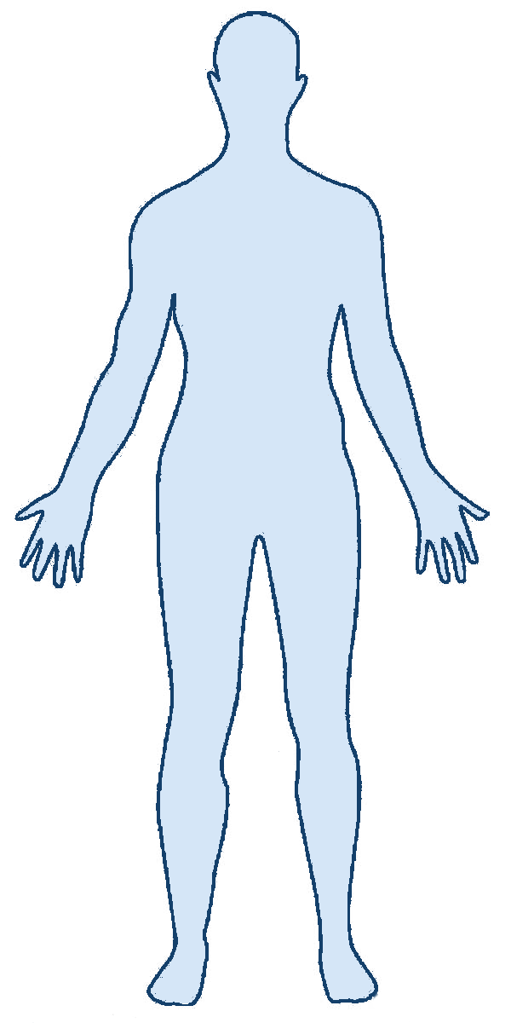
BELONGINGS
CLOTHING
Head
Eyes
Hat, helmet, etc.
Glasses, goggles, etc.
Neck
Necklace, tie, etc.
Back
Shoulders
Backpack, quiver, etc.
Cape, pauldron, etc.
Torso
Shirt, coat, etc.
Waist
Arms/Wrists
Belt, sash, etc.
Bracelets, watch, etc.
Right Hand
Left Hand
Rings, gloves, etc.
Rings, gloves, etc.
Legs
Trousers, skirt, etc.
Feet
Boots, shoes, etc.
Character Outline v1.0 by apheline, 2018
12

Slide 15
Other Belongings
Money:
Money on their person
Savings:
Money in a bank or otherwise stored away
Real Estate:
Any buildings or land that the character holds
Vehicle(s):
Any vehicles that the character owns
Pet(s):
Any pets that the character has
Held Items
Stored Items
Character Outline v1.0 by apheline, 2018
13

